Slide 1



Alternanza scuola-lavoro 2018/2019
SUIT

Slide 2
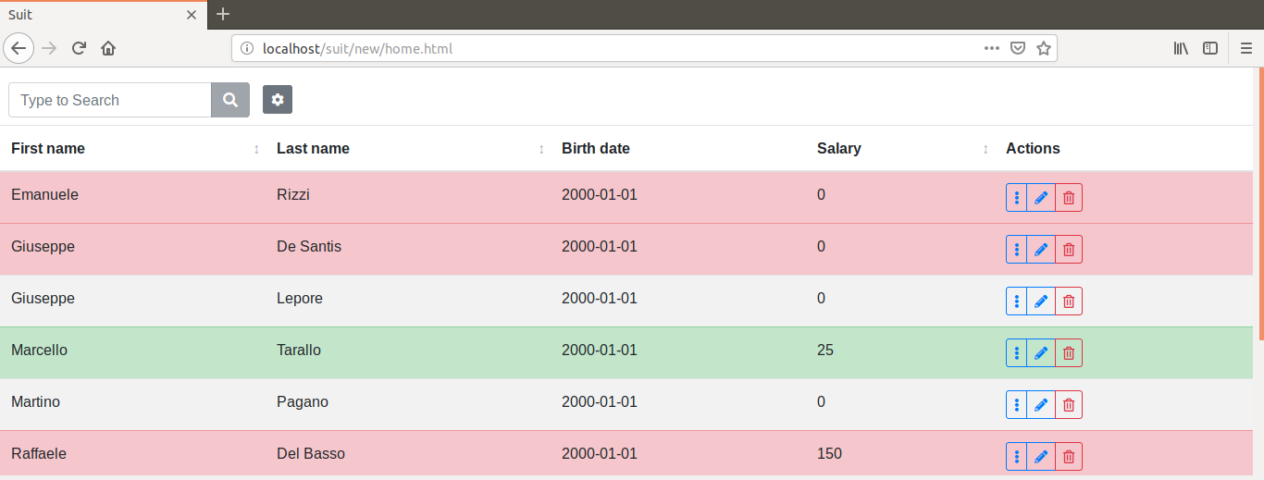
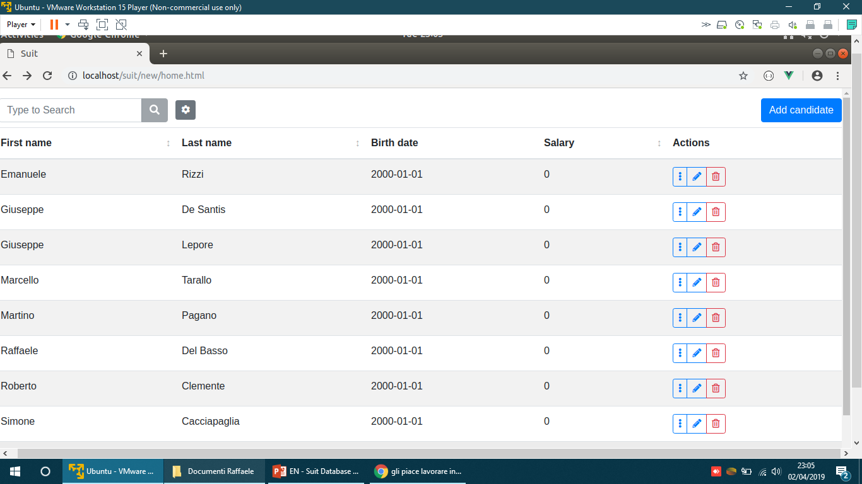

What is «Suit»?
Suit is our HR management web app that aims to simplify the process of finding and hiring employees.

Slide 3








How is it made?
Back-end
Front-end

Slide 4
How does it work?
The software has a top section which contains the search bar and the filter panel, and the main section which shows the candidates in a table.

Slide 5
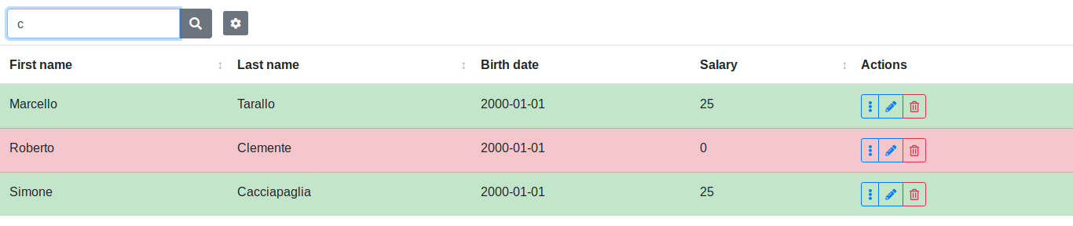
Search and filters • Search bar
The search bar allows you to search for a candidate by first name and last name using the incremental search method (case insensitive).

Slide 6
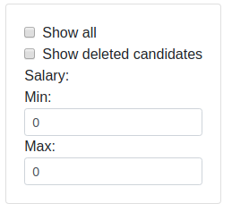
Search and filters • Filters
The following panel allows you to apply and combine filters for a more detailed search.

Slide 7
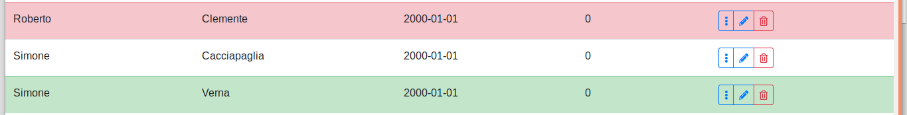
Rows and candidates
Rejected or hired candidate
Not deleted and not employed candidate
Employed candidate

Slide 8
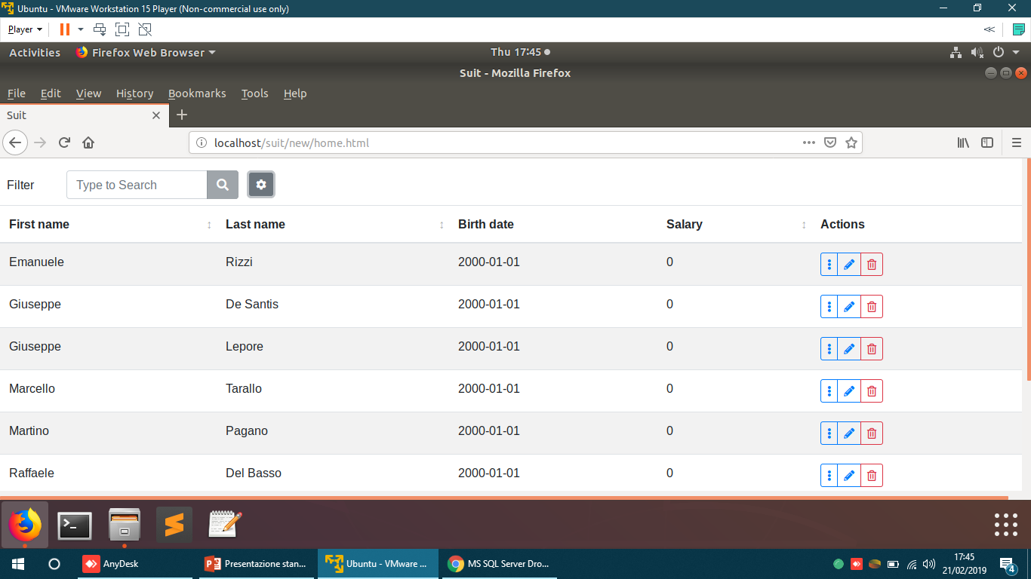
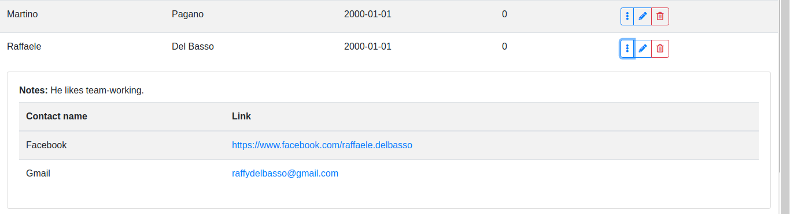
Action list • Details
This button allows you to see all the candidate information.
The row expands and shows the following information (if inserted):
Notes about the candidate;
All the contact links or mails which have been registered.
If you click on a web link, you will be redirected to the site you clicked (ex: Facebook profile);
If you click on an email, your email client will open.

Slide 9
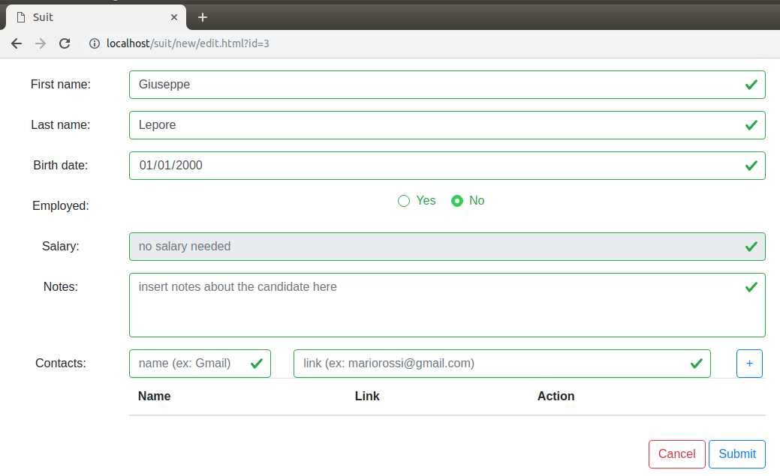
Action list • Candidate modification
This button lets you edit the candidate information.

Slide 10
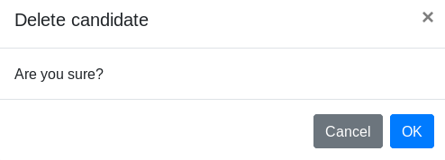
Action list • Candidate deletion
This button lets you delete the candidate. It will still be possible to see the deleted candidates through the filter panel.

Slide 11
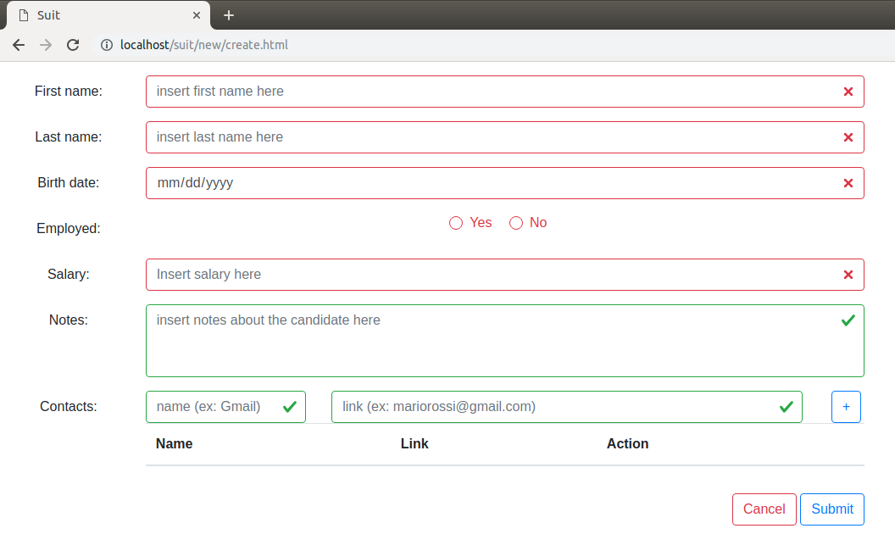
Candidate addition
This button lets you add a new candidate. The textfields are red when there is something wrong. Otherwise, they will be green. You can submit a candidate only if all the textfields are green.

Slide 12
Conclusions
Our software has the goal to help the company during the hiring process.
Coming features:
A better interface;
New filters.
The app might be updated in the future to allow to manage all the employees becoming a more general tool for the company.
GitHub project link: https://github.com/lt-scuolalavoro/suit

Slide 13

Thank you for the attention.

